Slide 1

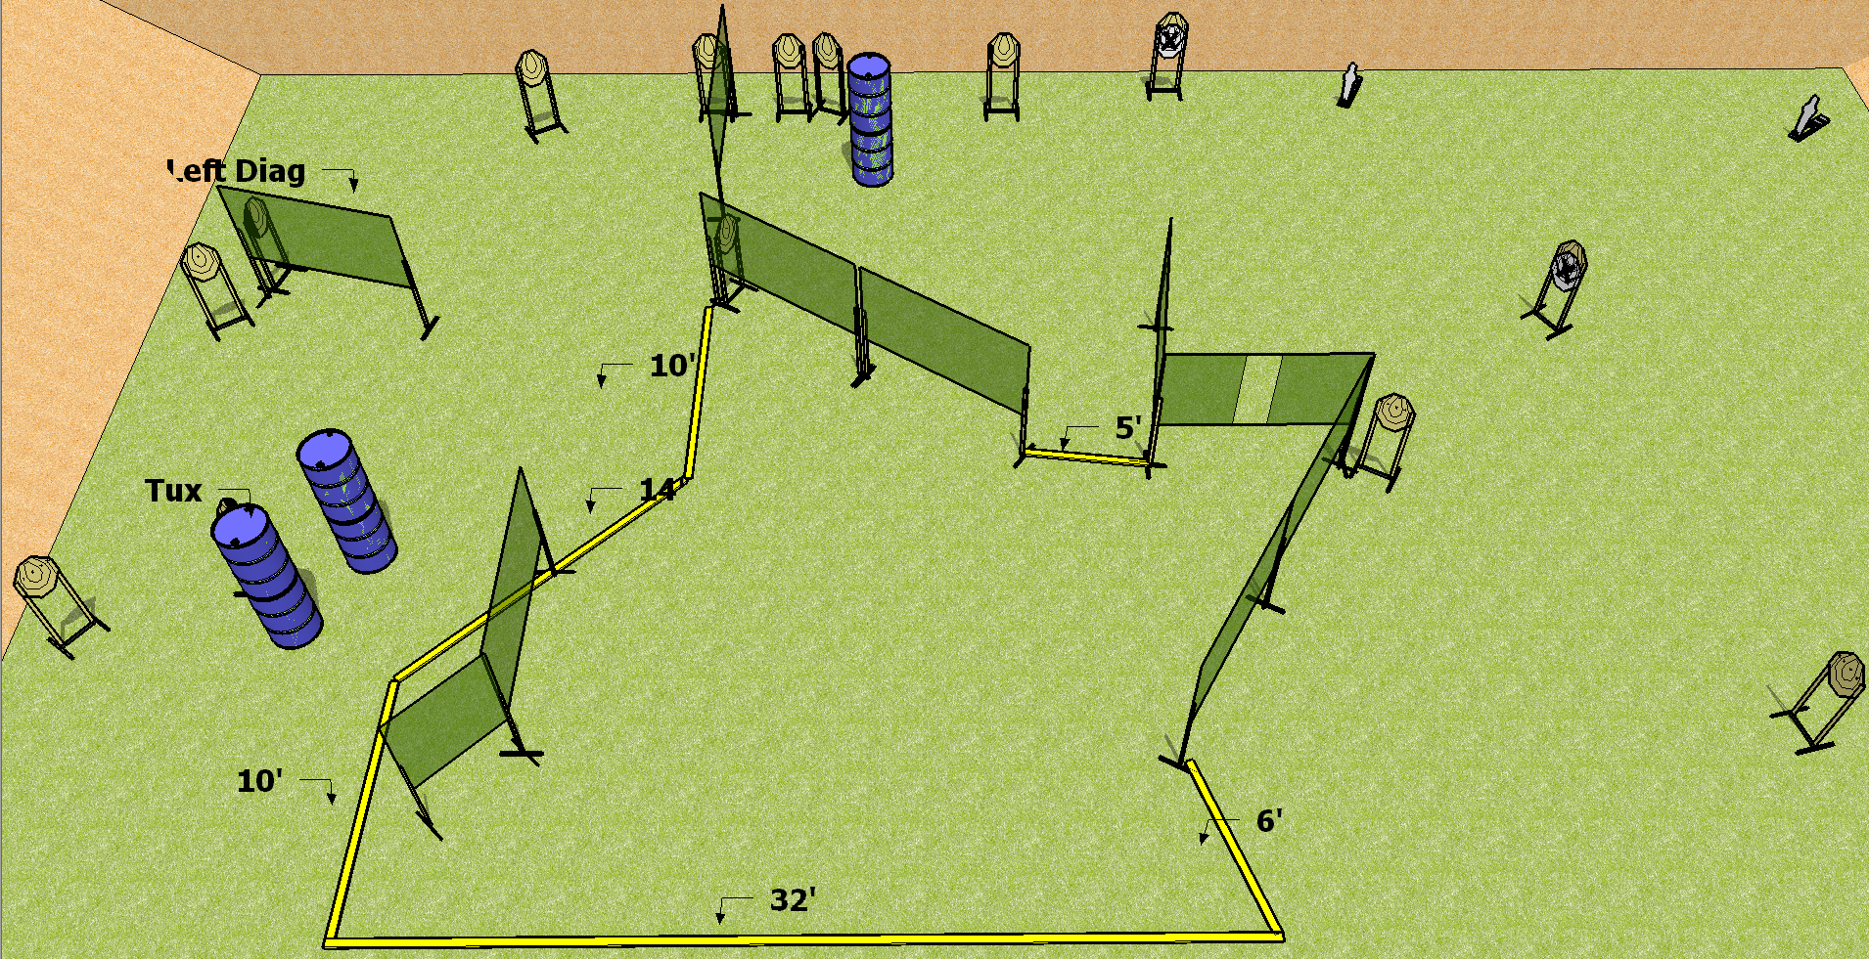
 | Dothan Practical Shooters – USPSA Match Newfangled Course Designer : Drew Coleman Bay: A3
Round Count 30 rounds 14 IPSC 2 mini poppers
Equipment List 17 wall feet 12 paper (12 + 2 NS) 1 tux, 1 left diag

Slide 2
Newfangled
Written Stage Briefing
Scoring: Comstock Rounds: 30
Targets: 14 IPSC, 2 steel
Handgun start position: anywhere inside the shooting area, wrists below belt. Handgun is loaded and holstered.
PCC start position: anywhere inside the shooting area, stock on belt. Loaded carbine is held with both hands, safety on.
Stage Procedure: on the audible start signal, engage targets as they become available from within the shooting area.

